Slide 1
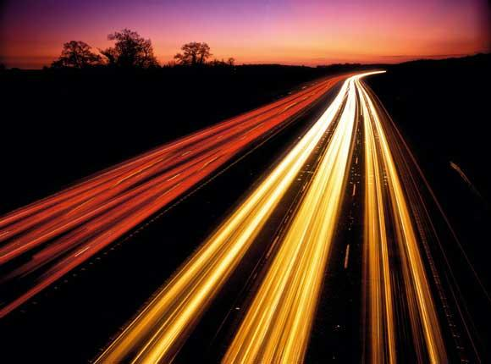
Hackathon @Endeavour
By Team_Gridlock.

Slide 2

Aim
We made an application for smart traffic management. We chose this domain, as this is quite a wide spread problem and people everywhere is facing it everytime they are on the roads. So we tried to come up with a solution in a much more practical and interactive way to help with this problem.The idea we are using for now is car pooling. Our database uses real time data sent by the users to monitor traffic for a particular area and also to give the stats about the roads, if they are okay to be travelled with.

Slide 3

A.T.S Applications :
Automated Traffic Management Systems (ATMSs): manage the flow of road traffic using a variety of technologies.
e-tolls: electronic toll booths deduct toll payments without stopping.
Electronic Road Pricing (ERP): requires drivers to pay different tolls at different times.
Traveler Information Systems: provide online, real-time information on road conditions.
Route guidance system: helps a driver navigate the best routes to a given location.
Car Pooling System: helps to reduce the number of cars on roads, by making an individual share his car.

Slide 4

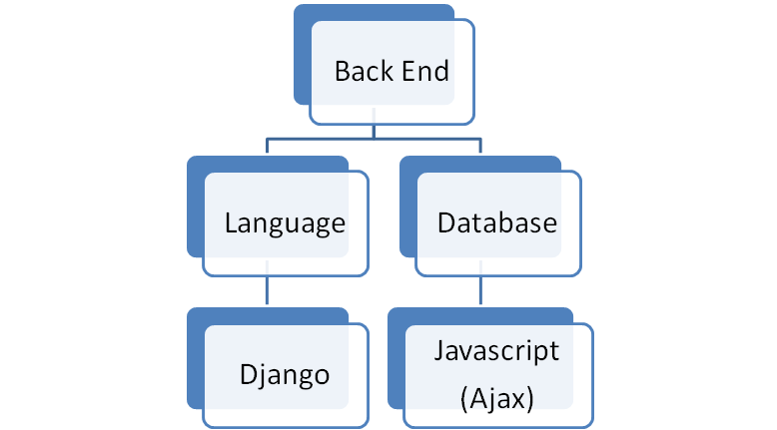
Technologies used.

Slide 5
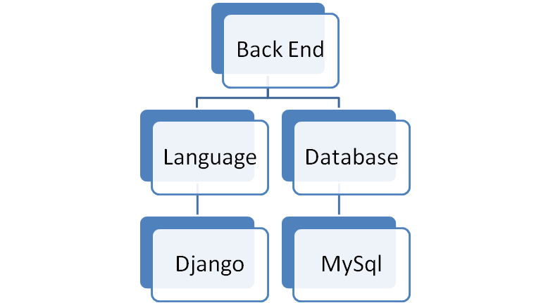

Slide 6
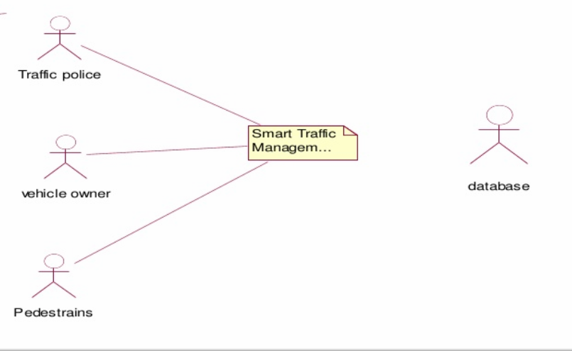
Overall Description And Working.
System Environment

Slide 7
Our system has three active actors one cooperating system. Mainly pedestrians, Traffic police and vehicle owners uses the dataset provided by the admin to give in all the info about the road and traffic status.
Software Interface:
Client : Web Browser, Android System
Web Server : DJango
Data Base Server : MySql
Development End : Python, Javascript, HTML, CSS.
Communication Interface:

Slide 8
•Client on Internet using will be using HTTP/HTTPS protocol.
•TCP/IP protocol is basic need for client side.
User Characteristics:
User should be comfortable using web browser.
User has to register with the STM.
Every user should have a unique user id and password.
Steps Involved :
Firstly we’ll get the users registered in our database for systematic interaction.
Now there are two ways in which user can use our system, either our website or our android application.
The user can use our app in many ways, if he wants to know the road status about the recent events that have happened on it e.g.

Slide 9
if he wants to know if the road has some damage on them or something that makes the road not really suitable for use.
If he wants some means to go from point A to point B (we have taken the range <2 Km for now) from the best possible route , to save himself ample amount of time
If a user is alone for a particular route he can avail his car for pooling which again is integrated in our application itself.
4. What is basically happening is we our taking all the data in real time from various mediums like traffic police, pedestrians, vehicle drivers to simulate the best possible means for our user to go from one point to another either alone or by pooling.

Slide 10
Future Integrations and Scope:
The first thing we can do is implement a kind of rewarding system so that when someone uploads any kind of true information or helps in pooling he is rewarded with some points or credits which he can use later in shops or anywhere he wants to. This can be more motivating for users.
Now this app can be very useful for emergency situations like accident or something , anyone using our app or website can upload the news that there is an emergency needed at a particular location and our app can alert everyone nearby, for help.
The biggest thing , we can save so much time and resources, with lesser vehicles there will be lesser traffic problems and also lesser carbon emission.
We can search the location of a vehicle or any pedestrian automatically.We can also add automatic fare collection system, so the user don’t have to wait at a toll or parking ,everything will be real time and location based.

Slide 11
End Of Slide.
Members Of Gridlock:
Devesh Shrivastava.
Rohan Mehta.
Anshul Gupta.
Arnav Saha.
THANK YOU All..

